Slide 1
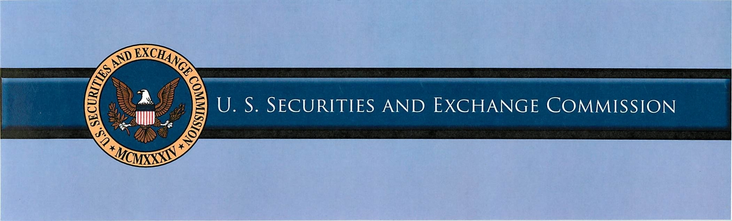

Overview of the SEC and
the Fort Worth Regional Office

Slide 2
Disclaimer
Remember:
The U.S. Securities and Exchange Commission, as a matter of policy, disclaims responsibility for any private publication or statement by any of its employees. Views expressed herein are those of the presenter and do not necessarily reflect the views of the Commission or other members of the staff of the Commission.

Slide 3
Overview of the SEC
Created by Congress in 1934 – after the Stock Market crash of 1929
The mission is to protect investors, maintain fair, orderly, and efficient markets, and facilitate capital formation
Principal Activities:
  Write rules, regulations, and policies
  Check for compliance with the rules
  Take enforcement action if not complying
  Provide information to the public

Slide 4
Overview of the SEC
Principal Statutory Authority:
  Securities Act of 1933
  Securities Exchange Act of 1934
  Investment Company Act of 1940
  Investment Advisers Act of 1940
  Sarbanes-Oxley Act of 2000 (“SOX”)
  Dodd-Frank Wall Street Reform and Consumer Protection Act (2010)

Slide 5
Overview of the SEC
Run by five Commissioners
  Chair Mary Jo White
  Each appointed by the President
  No more than three commissioners from same party
Workforce of 3900
  Smaller than the DC police department
  Oversees 35,000 + entities:
    11,700 investment advisers
    9700 mutual funds and ETFs
    4500 brokerage firms
    Stock market in which more than 8.5 billion shares are traded each day
    Financial statements and corporate disclosures for all public companies

Slide 6
Overview of the SEC
Five Divisions:
  Corporation Finance
    Offerings (issuers)
    Public companies
  Enforcement
    All registrants
  Investment Management
    Investment Advisers
    Investment Companies
  Trading and Markets
    Broker-Dealers
    SRO’s
    Transfer Agents
  Risk, Strategy, and Financial Innovation

Slide 7
Overview of the SEC
Eight Offices:
  Compliance, Inspections and Examinations
  Investor Education and Advocacy
  Chief Accountant
  Secretary
  General Counsel
  International Affairs
  Administrative Law Judges
  Legislative and Public Affairs

Slide 8
Overview of the SEC
Eleven Regional Offices:
  New York
  Boston
  Philadelphia
  Denver
  Fort Worth
  Salt Lake
  Chicago
  Los Angeles
  San Francisco
  Miami
  Atlanta

Slide 9
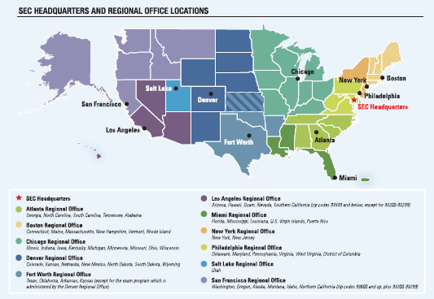
Overview of the SEC
Notes:
SEC is structured with its primary operations and headquarters in Washington DC.
That’s where the bulk of our employees are located, as well as all of our so-called policy divisions such as the Division of Corporation Finance, Division of Investment Management, Office of the Chief Counsel, Office of General Counsel and so on.
We have 11 regional offices spread across the country. These offices are almost entirely comprised of Enforcement staff like myself, and our broker-dealer and investment adviser/investment company examination staff.
Each regional office has a primary region of responsibility, which is shown on this map, but there’s nothing that prevents us from pursuing cases in other parts of the country – that is, unlike US Attorney’s Offices, we investigate and litigate cases wherever our cases take us. E.g., going to trial next month in New Mexico, and earlier this summer had a trial set in Southern California.
But generally our examiners focus on their own regions, and we in Enforcement do as well to promote efficiency and reduce travel costs.
Source: U.S. Securities and Exchange Commission Fiscal Year 2013 Agency Financial Report

Slide 10
Overview of the SEC
Regional Offices – two principal activities:
  Enforcement
    Director Andrew Ceresney
    Deputy Director Stephanie Avakian
    Investor protection
    Conducts investigative activities and court litigation
  Compliance, Inspections, and Examination
    Acting Director Marc Wyatt
    Carries out the National Examination Program for investment advisers, investment companies, broker-dealers, municipal securities dealers, transfer agents, clearing agencies, self-regulatory organizations, municipal advisors

Slide 11
The Fort Worth Regional Office
Region covers Texas, Oklahoma, Kansas and Arkansas
  Fastest growing state and three fastest growing metros in US (Austin, Houston and Dallas)
  468 NYSE and Nasdaq companies
  More than 1,000 public reporting companies
  64 Fortune 500 companies (2014 rankings)
    Three of six largest: Walmart, Exxon Mobil, and Phillips 66
    Arkansas (7) has second largest concentration of F-500 in our region, behind Texas

Slide 12
The Fort Worth Regional Office
119 Total Employees
  66 Enforcement staff
    41 Attorneys
    10 CPA Accountants
    10 paralegals
  44 Examination staff
    26 IA/IC
    12 Broker-Dealer
  1 Geophysicist on staff

Slide 13
Enforcement Program Highlights

Slide 14
Specialty Units
SEC has five specialty units, three of which are represented in FWRO
  FCPA
  Asset Management
  Complex Financial Instruments
  Municipal Securities
  Market Abuse

Slide 15
Key Features of our Investigations
Self-contained: Investigate and litigate our own cases
Purely civil jurisdiction
Can sue in federal court or administratively
Broad investigative powers but key limitations imposed by Privacy Act and other acts
Specifically authorized to collaborate with DOJ

Slide 16
Types of Cases
Financial reporting and disclosure
Insider trading
FCPA
Broker-dealer, investment adviser & investment company
Market manipulation
Offering frauds & Ponzi schemes
  Affinity frauds, especially religious affinity
  Oil & gas offerings
  Very crude to highly sophisticated

Slide 17
Subpoenas
  Administrative, not court, subpoenas
    Staff drafts and sends
    Not self-executing
    Enforceable through federal court action
    Not subject to Rules of Civil Procedure

Slide 18
Sworn Testimony
Usually starts after documents reviewed
Similar to depositions, with key differences
  Staff administers the oath
  No right to cross-examine
  FRCP and FRE don’t apply
  No right to receive the written transcript (but usually allowed)
  Limited attendance

Slide 19
Sharing Information
SEC can share information with DOJ and other law enforcement. Rule 24c-1 of Exchange Act.
  Courts have explicitly approved DOJ/SEC collaboration. E.g., US v. Kordel, US v. Stringer
  Sharing information requires approval of assistant director or above. Sharing documents requires written access request.
Under Dodd-Frank Act, we can share privileged materials with other agencies without waiving the privilege. Exchange Act Section 24(f).

Slide 20
Enforcement Action
Staff drafts recommendation describing the factual and legal bases for bringing case
  We can and sometimes do share the factual summaries with the USAO and FBI
Recommendation reviewed and commented on by HO, including General Counsel’s Office and other interested divisions and offices
  Review intended to promote consistency and solid legal foundation
Can be time consuming process

Slide 21
Recommending Action to the Commission
After action memo vetted by staff, goes to Commissioners
  Usually considered at closed meeting (i.e. non-public)
  Can be reviewed quickly and approved by a single Commissioner if an emergency matter
Once approved, we file the action
  Have to return to the Commission for further authority to take certain actions (e.g., settlement, add/drop parties or charges)

Slide 22
Federal District Court
Emergency Cases – ongoing fraud, investor funds at risk
  Temporary Restraining Order
  Preliminary Injunction
  Asset Freeze
  Receiver – takes possession of all documents and things. Can turn over to criminal authorities.
  Surrender of passport.
  Expedited Discovery – put defendant on the record on 72 hours’ notice.

Slide 23
Federal District Court (cont’d)
Non-Emergency Cases.
  Injunction against further violations of the securities laws. So-called obey-the-law injunction.
  Conduct-based injunction.
  Officer-and-director bar.
  Penny-stock bar.
  Disgorgement of any money obtained from the illegal conduct.
  Civil Penalties. Third-tier: up to $165,000 per violation or amount of pecuniary gain.

Slide 24
Federal District Court (cont’d)
Non-Emergency Cases (cont.)
    But – insider trading cases are different. Maximum penalty is 3x the amount of profits gained or losses avoided.
  SOX 304: restatement due to misconduct (not necessarily by defendant); defendant must reimburse issuer amount of bonus or stock-based compensation received during 12 months following financial misreporting.

Slide 25
Administrative Proceedings
Post-Dodd Frank – can get nearly all same remedies as district court.
Cease-and-desist orders.
Undertakings – procedures to prevent further violations.
Bar a firm from acting as a securities firm or an investment adviser, or individual from the securities industry.
Rule 102(e): Bar a professional from practice before the Commission.

Slide 26
Examination Process

Slide 27
Regional Registrant Demographics
Investment Advisers
  669 Registered Investment Advisers (6% of all SEC registered advisers)
  $1.745 trillion in AUM (3% of total AUM of registered advisers)
  36% indicate that they manage private funds
  42% have custody (including through a related person)
  4% are also broker-dealers
Broker-Dealers
  264 registered BDs (~6% of all SEC registered broker-dealers)
  14,003 branch offices (~9% of total)
  $10 billion in assets
  1,007,320 customer accounts held
  54,345 associated individuals
Other
  51 Municipal Advisor Registrants
  32 Transfer Agents

Slide 28
Examination Process
Consists of:
  Exam Selection
  Exam Assignment
  Exam Scope
  Exam Work
  Exam Disposition

Slide 29
Exam Selection
  Office of Compliance & Examinations Risk Department in D.C. & Regional Offices
    Identify firms as High Risk based upon business operations, products, revenues, etc.
    Identify firms as part of National Sweeps
    Identify newly registered firms or firms that have never been examined
    Identify firms through Tips, Complaints, and/or Referrals from other SEC offices, other agencies, or the public
    Assigned to Regional Offices where firm is located
    Regional offices select firms from this list

Slide 30
Exam Assignment
Associate and Assistant Regional Directors – break up the firms they have selected (i.e. IA/IC or BD/TA)
Exam Managers are then assigned to oversee the completion of the exam
Exam Team created – based upon knowledge level of products offered or sold by the firm, and staff availability
Exam Team consists of:
    Exam Manager
    Lead Examiner
    Supporting/Assisting Examiner(s) – depending on size of firm, could be multiple supporting examiners

Slide 31
Exam Scope
Determining Scope
  Initially based upon risks identified during selection process
  May be extremely focused (if TCR, or Sweep)
  May be pretty broad if firm has never been examined before
Scope will identify focus areas for the exam team
  Focus area can be adjusted during the pre-exam and/or on-site fieldwork stages of the exam.

Slide 32
Exam Work
Three Stages
  Pre-Fieldwork
  Fieldwork (on-site)
  Post-Fieldwork

Slide 33
Pre-Fieldwork
Review databases, filings, past examination reports, past enforcement actions, financials, registrations, complaints, etc.
Review firm websites, news articles, and any other internet search results related to the firm
At this point, we could adjust scope if needed based upon pre-exam review
We may also review modules related to the scope or focus areas of the exam (modules are references/guides that aid in performing specific reviews)
We may also review no-action letters or any interpretive releases related to any of the focus areas of our scope

Slide 34
Pre-Fieldwork (cont’d)
Notify Firm
    We typically notify the firm during the pre-fieldwork process of the upcoming examination (usually a week to two weeks before the on-site fieldwork begins)
    During the notification call with the firm, we gather some general info about the firm (business activities, types products sold, number of employees, number of customers, fees charged, etc.)
    Following the call we send the firm a document request list.

Slide 35
Fieldwork
We meet on-site with firm personnel and discuss the firm’s operations, structure, policies and procedures, and other topics as they may relate to the focus areas of the exam.
Remainder of the week is spent reviewing the requested documentation and meeting additional firm personnel.
During this stage, we may make additional requests if necessary and review

Slide 36
Post Fieldwork
Reviews continue back in the office.
The exam staff typically spends a few additional weeks finishing reviews, and researching various regulatory issues (securities laws, interpretive guidance, and no-action letters to support any/all findings identified during the exam).
Memorialize exam work in an internal exam report. The report typically identifies the focus areas of the exam along with the reviews performed, and any violations of securities laws identified during the exam.

Slide 37
Exam Disposition
Generally three types of outcomes to an exam:
  No findings resulting No Further Action Taken (rarest outcome)
  Deficiency Letter
      A letter to the firm that identifies all of the areas where we found that the firm failed to comply with Securities Laws.
      Deficiency Letters require a timely response from the firm regarding corrective action
      Also, provides opportunity to present facts if they feel our findings are incorrect.
  The exam is referred to another SEC division or separate agency
      SEC Enforcement Referral
      SRO Referral (FINRA, CFTC, etc.)
      State Securities Board Referral (TSSB)
      Other SEC Offices or other Divisions (Regional, TM, CorpFin, etc.)

Slide 38
